Slide 1

The effectiveness of preregistration in psychology
Olmo van den Akker
Tilburg University

Slide 2
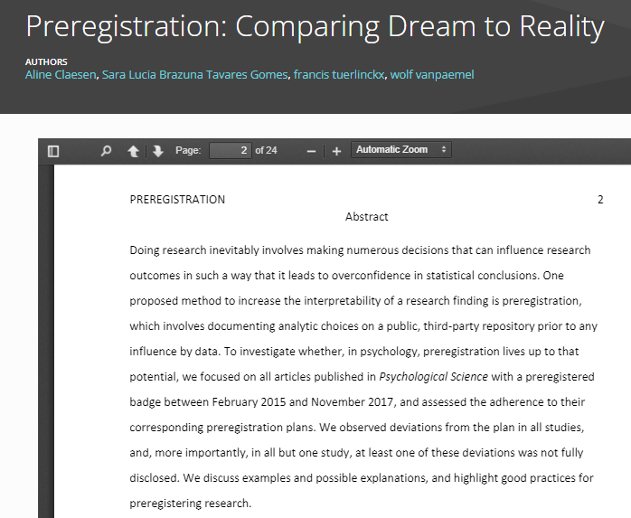
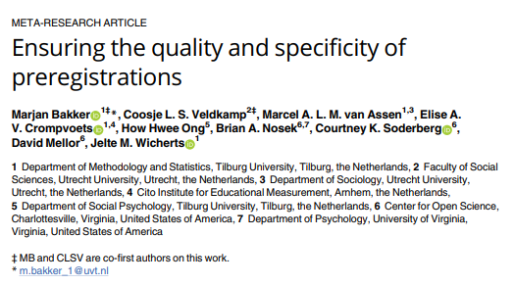
What is preregistration effectiveness?
Preregistration Specificity
Preregistration-study consistency
Preregistration effectiveness = Preregistration specificity + Preregistration-study consistency
(producibility)

Slide 3


Sample
N = 180
N = 244
No studies from other fields than psychology
No studies based on secondary data
No Registered Reports
Final N: 484 studies from 281 papers

Slide 4
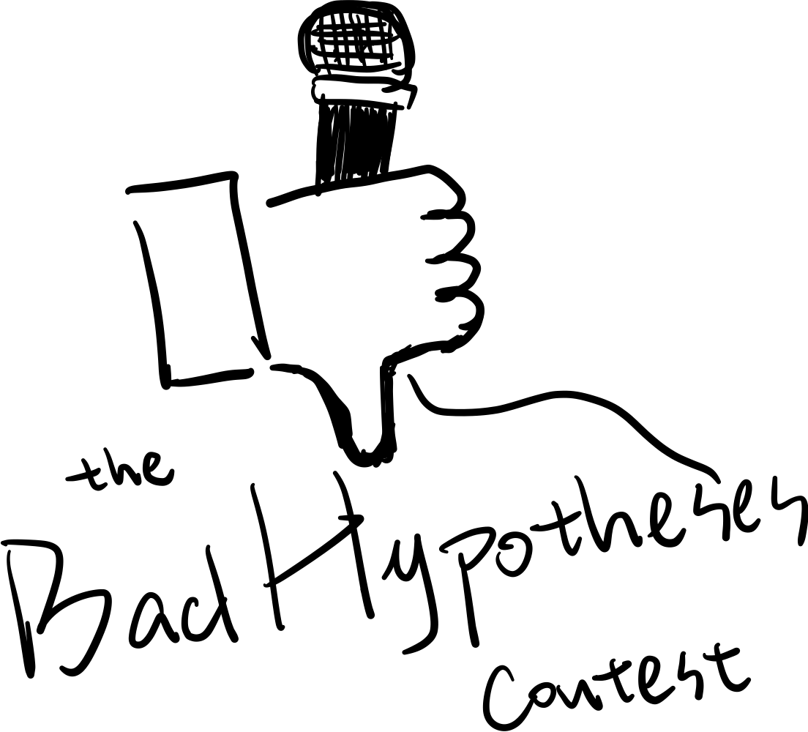

Design
Part 1: Hypotheses
Specificity → Marcel van Assen (first talk)
Preregistration-paper consistency
“About half of preregistered hypotheses are omitted” “About half of studies add non-preregistered hypotheses”
https://www.elisevanderpol.nl/badhypothesiscontest
Part 2: Other study elements
Specificity
Preregistration-paper consistency
Notes:
Top pic: https://www.elisevanderpol.nl/badhypothesiscontest/
Bottom pic: https://ueg.eu/a/260

Slide 5
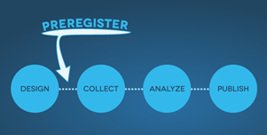
Selective Hypothesis Reporting
Identifying hypotheses:
Search for separate Hypothesis section
Search for keywords in running text: “replicat” (for replication studies), “hypothes”, "investigat", “test”, “predict”, “examin”, and “expect”
Include a prediction regarding the relationship between two or more variables (or between a variable and a proposed value)
Add control variables and different operationalizations from other sections

Slide 6
Types of Selective Hypothesis Reporting
 | Preregistration | Paper
Omitted hypotheses (intro) | Yes | No
Omitted hypotheses (results) | Yes | No
Added hypotheses | No | Yes

Slide 7
Omitted Hypotheses and Added Hypotheses
Data collected from 467 out of 484 (97%) preregistration-study pairs (PSPs)
Data collected for 2,177 hypotheses (4.6 per PSP)
 | # SRH | # studies with SRH
Omitted hypotheses (intro) | 964 / 2,177 (44%) | 238 / 467 (51%)
Omitted hypotheses (results) | 1,015 / 2,177 (47%) | 224 / 467 (48%)
Added hypotheses | NA | 221 / 398 (56%)
→ Results might be skewed because of low quality hypotheses in preregistrations (and papers)

Slide 8
Hypotheses with a direction change
2,177 hypotheses
964 hypotheses omitted (44%)
1,057 hypotheses with the same direction (49%)
156 hypotheses with a different direction (7%)

Slide 9
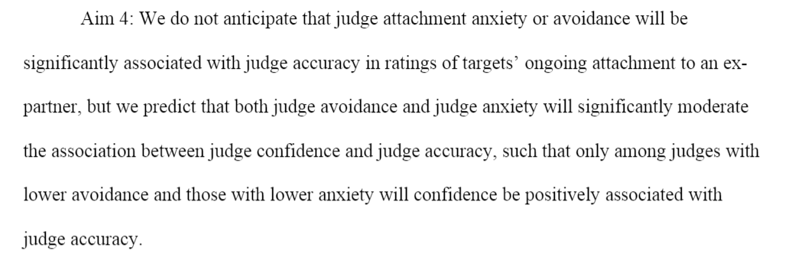
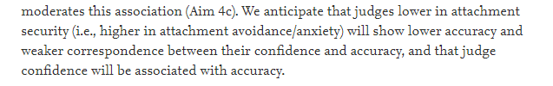
Example of a direction change
Preregistration:
Paper:

Slide 10
Beyond Selective Hypothesis Reporting
Step 1
Randomly select non-SR hypothesis from each PSP
Step 2
Assess preregistration specificity for certain study elements
Step 3
Assess preregistration-study consistency for certain study elements
Step 4
Compute preregistration effectiveness score
Preregistration effectiveness = Preregistration Specificity + Preregistration-study consistency
Data collected for 55 out of max. 484 preregistration-study pairs (PSPs)

Slide 11
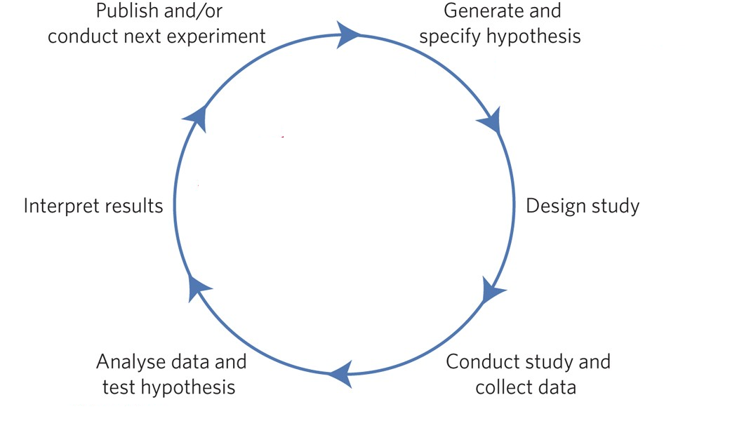
Part 2 -Study Elements
Essential elements
Independent variable
Dependent variable
Data collection procedure
Statistical model
Inference criteria
Non-essential elements
Third variable
Control variable
Inclusion / exclusion criteria
Missing data
Statistical assumptions
Outliers
→ Data collected for 55 out of max. 484 PSPs → Data based on only one hypothesis per PSP
Notes:
Right pic adapted from https://www.nature.com/articles/s41562-016-0021

Slide 12
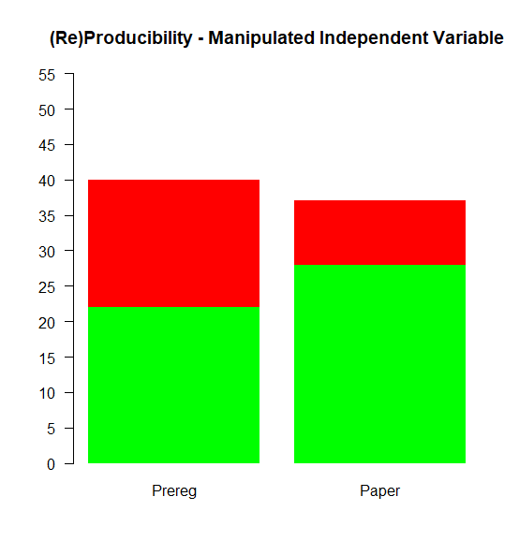
Specificity – Independent Variable

Slide 13
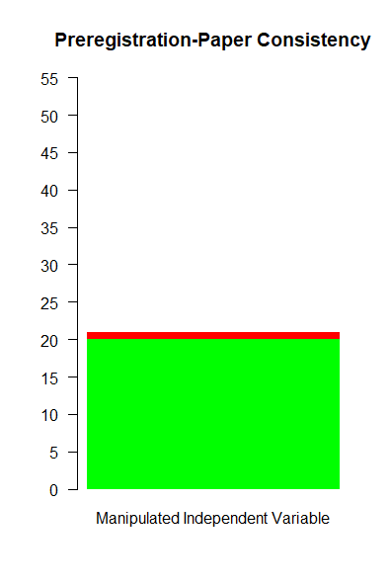
Consistency – Independent Variable

Slide 14
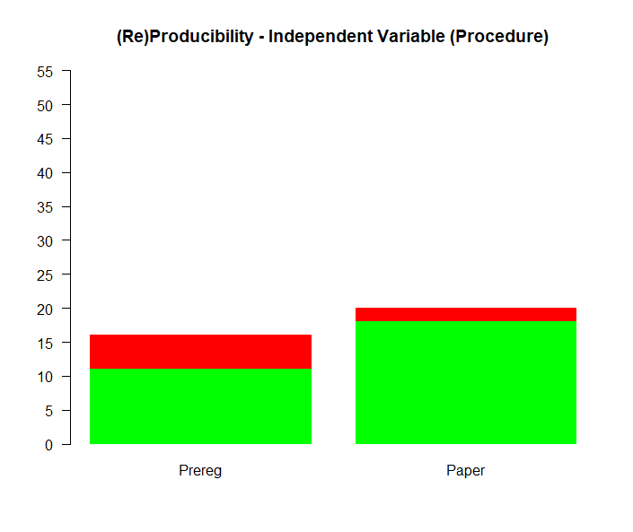
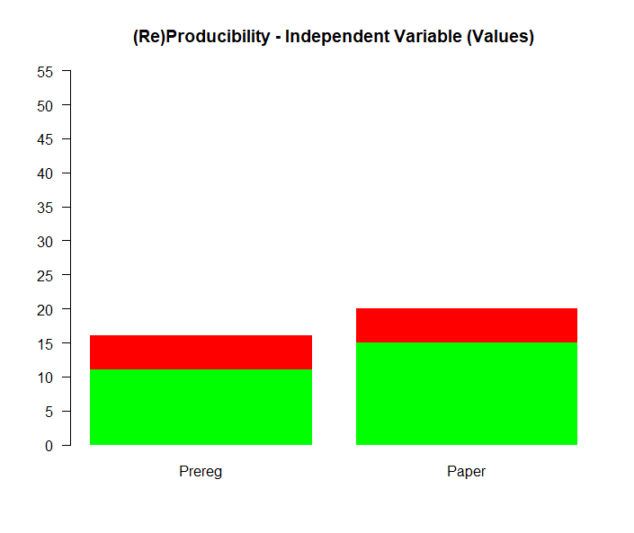
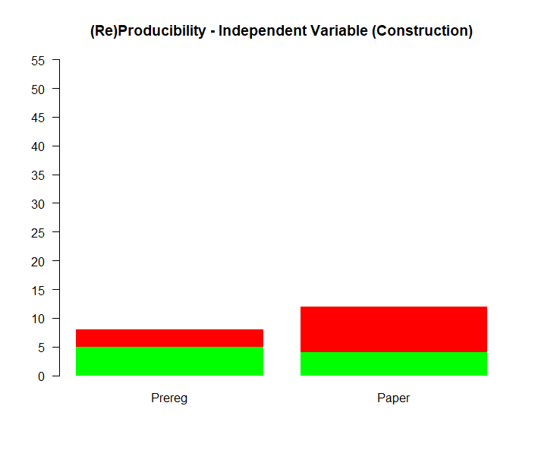
Specificity – Independent Variable

Slide 15
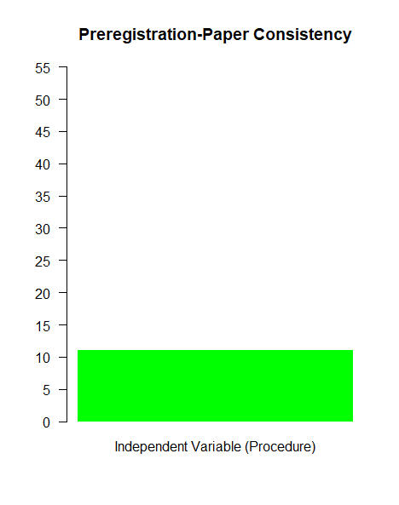

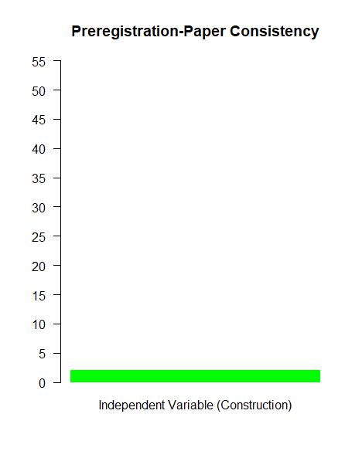
Consistency – Independent Variable

Slide 16
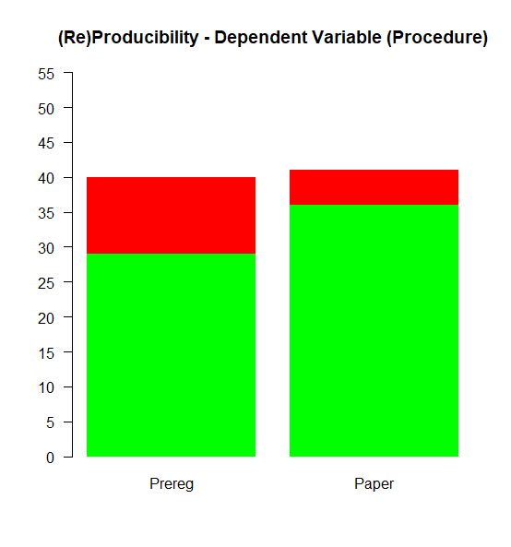
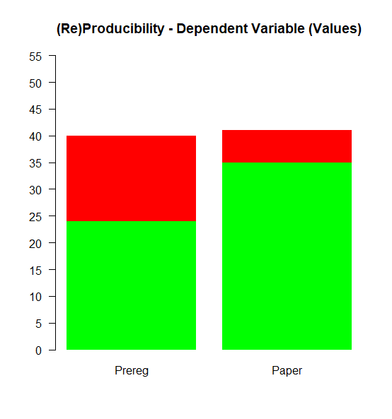
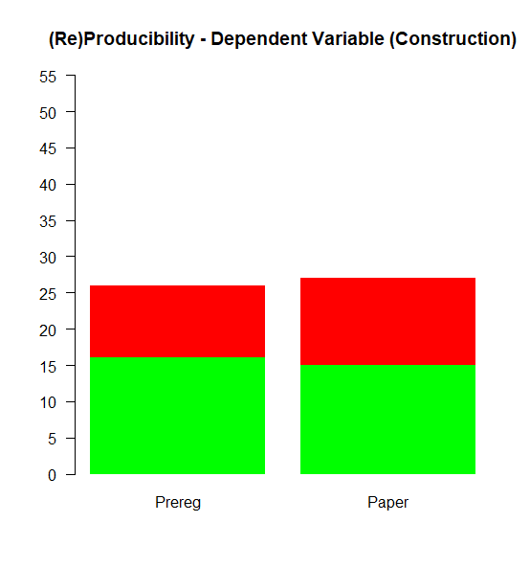
Specificity – Dependent Variable

Slide 17
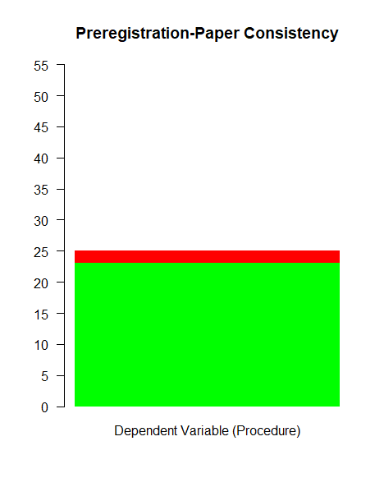
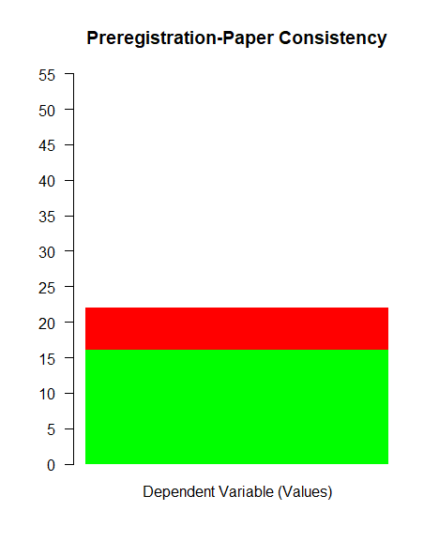
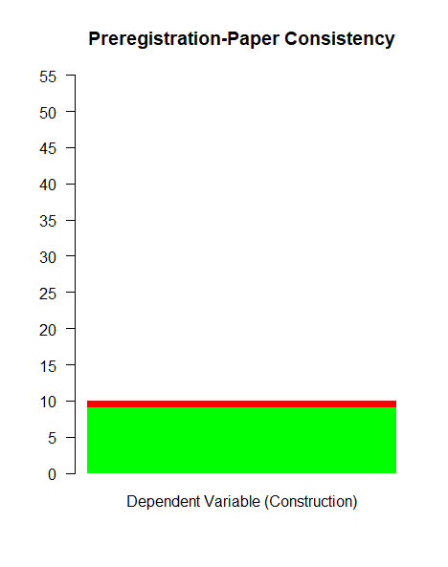
Consistency – Dependent Variable

Slide 18
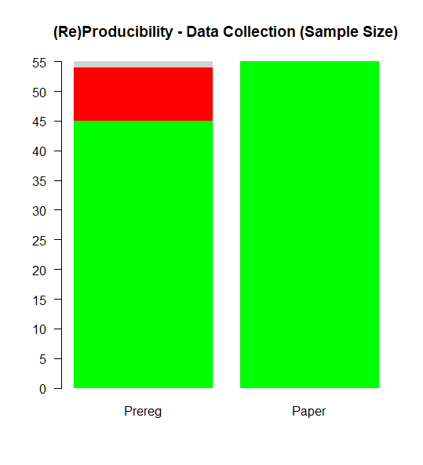
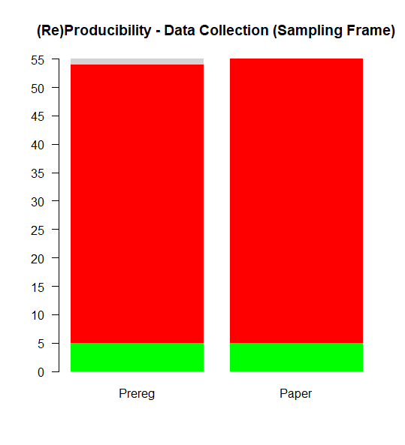
Specificity - Data Collection Procedure

Slide 19
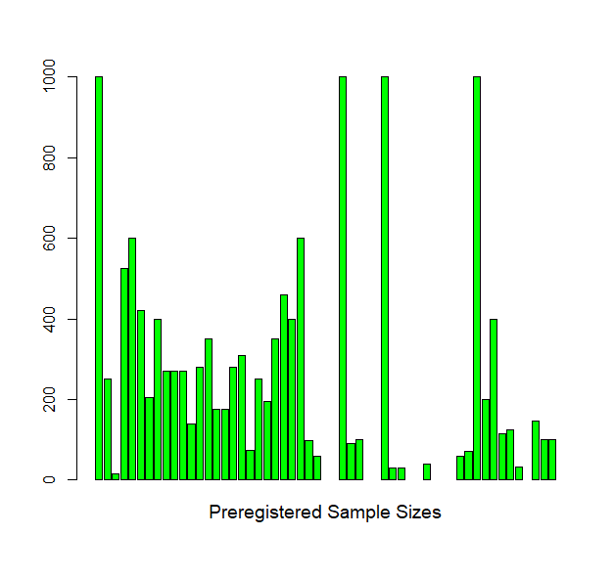
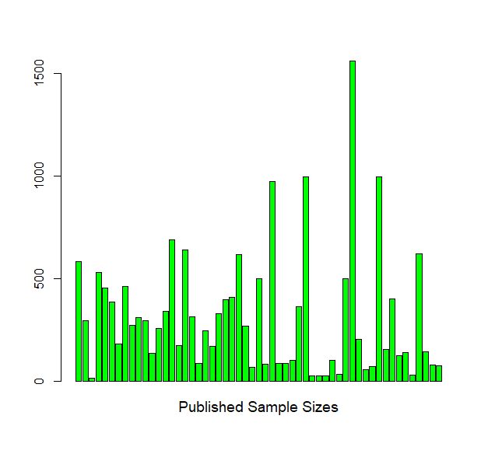
Consistency - Sample Size Differences

Slide 20
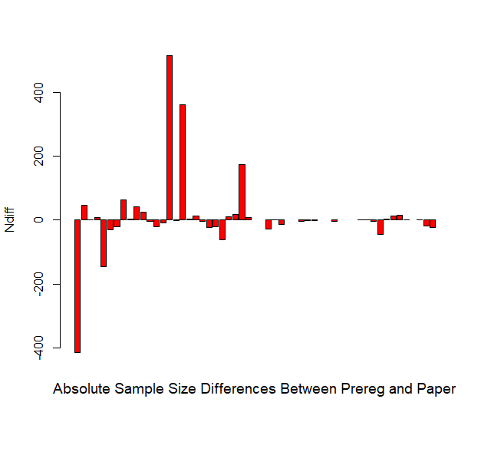
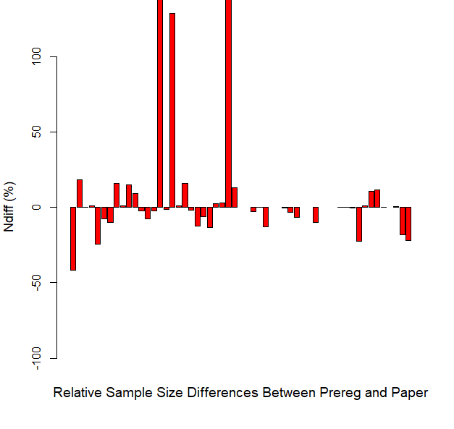
Consistency - Sample Size Differences
Notes:
Still looking at reasons for deviations

Slide 21
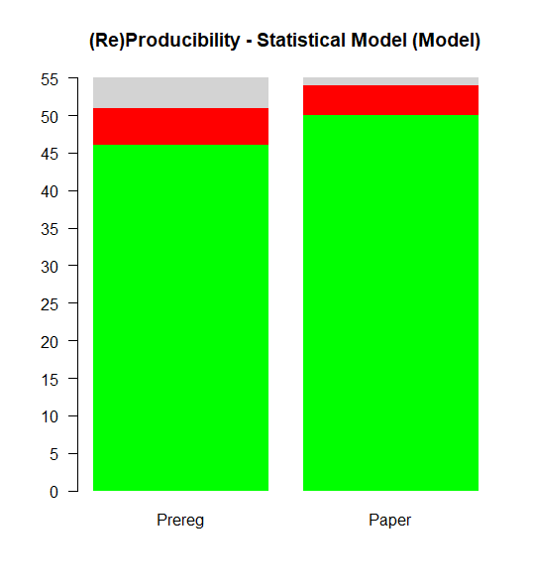
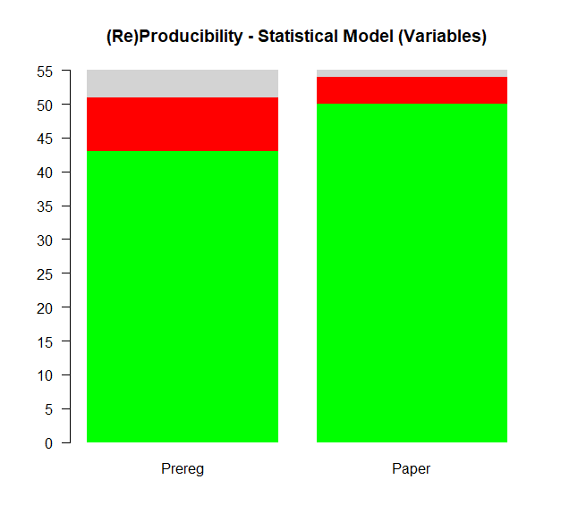
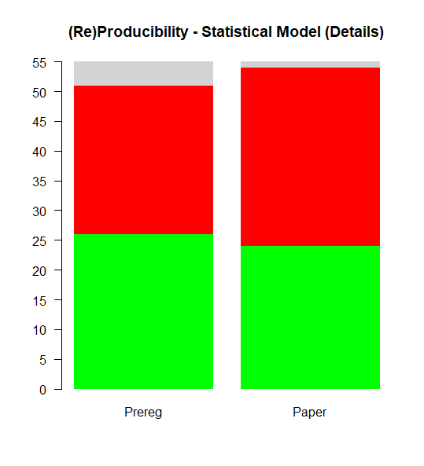
Specificity - Statistical Model

Slide 22
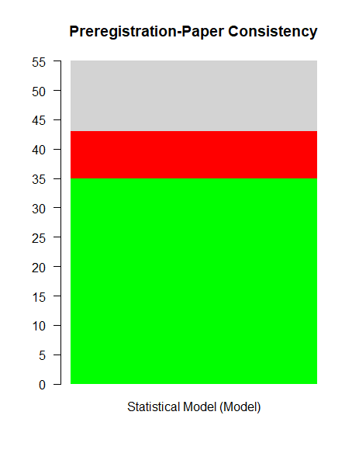
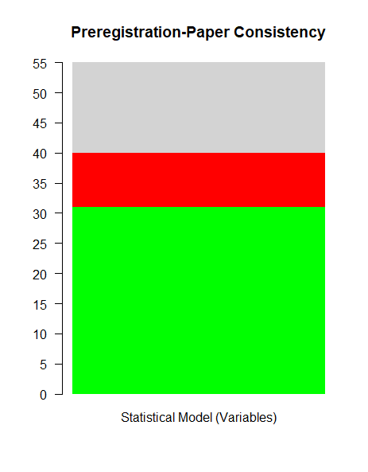
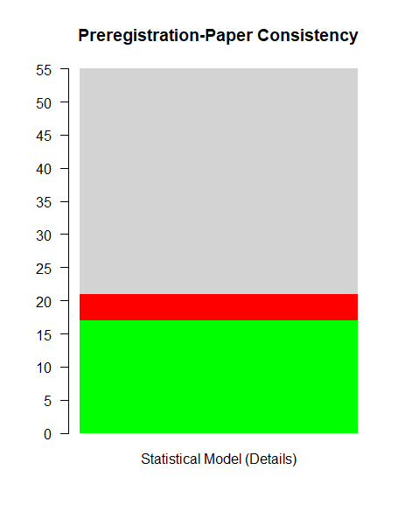
Consistency – Statistical Model

Slide 23
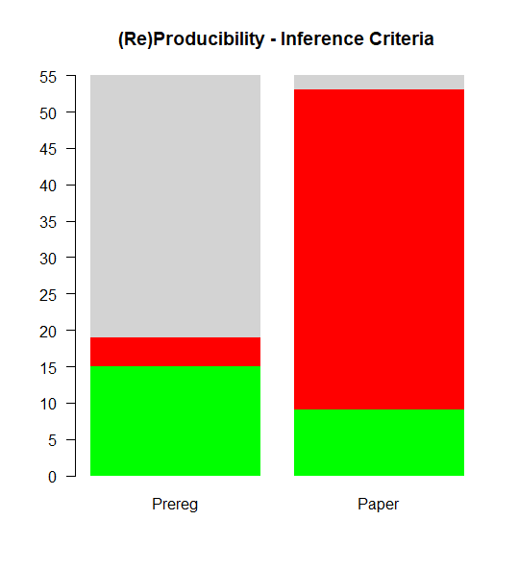
Specificity - Inference Criteria

Slide 24
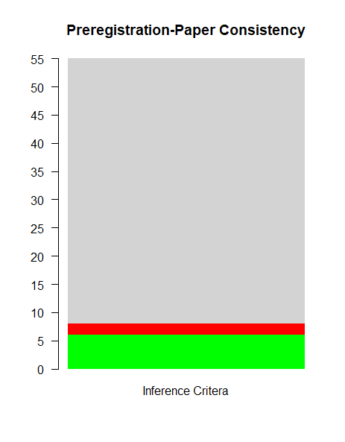
Consistency – Inference Criteria

Slide 25
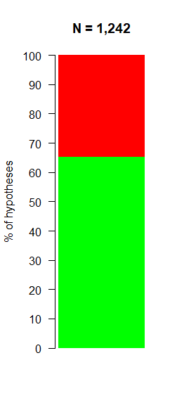
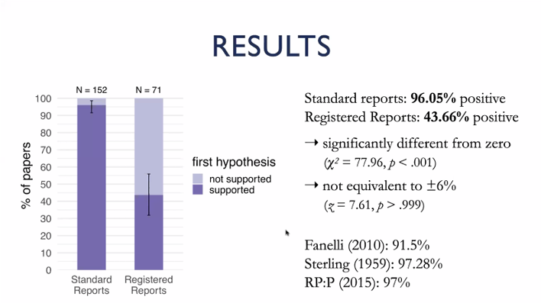

Proportion of supported hypotheses
Notes:
Left pic from https://journals.sagepub.com/doi/full/10.1177/25152459211007467

Slide 26
Conclusions
Selective hypothesis reporting seems to be prevalent in psychology
It is hard to compare preregistrations and papers because both preregistrations and papers lack (re)producible information about important study elements
When information is available, most preregistrations align with their corresponding preregistrations
Preregistration does seem to have the expected effect on the proportion of positive results in the literature

Slide 27
To reap the benefits of preregistration, preregistration producibility and paper reproducibility should be significantly improved

Slide 28
Co-authors
Selective Hypothesis Reporting |  | Preregistration Effectiveness
Marcel van Assen | Marjan Bakker | Marcel van Assen | Marjan Bakker
Manon Enting | Myrthe de Jonge | Shilaan Alzahawi | Alexandra Sarafoglou
How Ong | Franziska Rüffer | Charlotte Pennington | Leone Verweij
Martijn Schoenmakers | Andrea Stoevenbelt | Sarah Schoch | Maksim Sitnikov
Jelte Wicherts |  | Aline Claesen | Daniel Dunleavy
 |  | Dwayne Lieck | Sarahanne Field
 |  | Jelte Wicherts | You?

Slide 29

This is the final slide of this talk
E-mail: ovdakker@gmail.com
Selective Hypothesis Reporting Preregistration: https://osf.io/z4awv
Preregistration Effectiveness Preregistration: https://osf.io/83ahg
All data will become openly available on OSF

Slide 30
Hypotheses with a status change
466 hypotheses with primary importance
139 hypotheses omitted (30%)
261 hypotheses with unspecified importance (56%)
52 hypotheses with primary importance (11%)
14 hypotheses with secondary importance (3%)

Slide 31
Hypotheses with a status change
183 hypotheses with secondary importance
126 hypotheses omitted (69%)
36 hypotheses with unspecified importance (20%)
21 hypotheses with secondary importance (11%)
0 hypotheses with primary importance (0%)

